Slide 1
2ECOE76 MATLAB for Engineers Lecture 2
Prepared by
-Twinkle Bhavsar

Slide 2
Outline
Variables and Arrays
Creating and Initializing Variables in MATLAB
Multidimensional Arrays

Slide 3

Array
Fundamental unit of data in MATLAB
A collection of data values organized into rows and columns

Slide 4

Array
Vector
Matrix
used to describe an array with only one dimension
used to describe an array with two or more dimensions
>>a=[1 -2 -3 -4 5]
a = 1 -2 -3 -4 5
>>b=[1 2 3;4 5 6;7 8 9]
b =
1 2 3 4 5 6 7 8 9

Slide 5
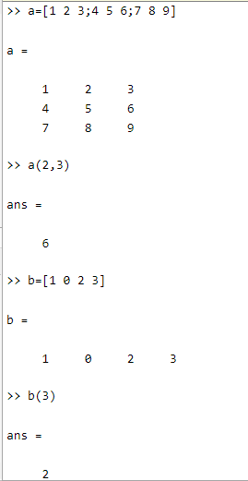

Individual data values within an array are accessed by including the name of the array followed by subscripts in parentheses that identify the row and column of the particular value.

Slide 6

Variable
It is a region of memory containing an array, which is known by a user-specified name.
MATLAB variable names must begin with a letter, followed by any combination of letters, numbers, and the underscore (_) character.
Only the first 63 characters are significant; if more than 63 are used, the remaining characters will be ignored.

Slide 7
Spaces cannot be used in MATLAB variable names.
The MATLAB language is case sensitive, which means that uppercase and lowercase letters are not the same. Thus the variables “name, NAME, and Name” are all different in MATLAB.

Slide 8


Types of MATLAB variables
Double
Char

Slide 9


Type “Double”
consists of scalars or arrays of 64-bit double-precision floating-point numbers.
can hold real, imaginary, or complex values.
The real and imaginary components of each variable can be positive or negative numbers in the range to , with 15 to 16 significant decimal digits of accuracy.
is the principal numerical data type in MATLAB.
is automatically created whenever a numerical value is assigned to a variable name.

Slide 10
can be real, imaginary, or complex.
A real value is just a number.
var = 10.5
An imaginary number is defined by appending the letter i or j to a number.
var = 4i
A complex value has both a real and an imaginary component. It is created by adding a real and an imaginary number together.
var = 10 + 10i

Slide 11
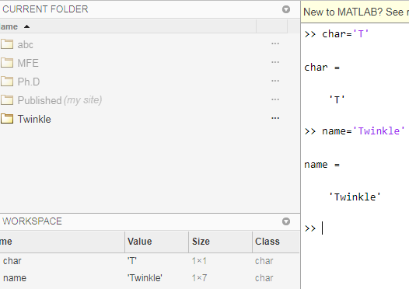
Type “char”
consists of scalars or arrays of 16-bit values, each representing a single character.
Arrays of this type are used to hold character strings.
They are automatically created whenever a single character or a character string is assigned to a variable name.

Slide 12

In a language such as C, the type of every variable must be explicitly declared in a program before it is used. These languages are said to be strongly typed.
In contrast, MATLAB is a weakly typed language. Variables may be created at any time by simply assigning values to them, and the type of data assigned to the variable determines the type of variable that is created.

Slide 13
Outline
Variables and Arrays
Creating and Initializing Variables in MATLAB
Multidimensional Arrays
Subarrays

Slide 14





Creating and Initializing Variables in MATLAB
MATLAB variables are automatically created when they are initialized.
There are three common ways to initialize a variable in MATLAB:
Initializing Variables in Assignment Statements
Initializing with Shortcut Expressions
Initializing with Built-In Functions
Initializing Variables with Keyboard Input

Slide 15
Initializing Variables in Assignment Statements
var = expression;
where, var is the name of a variable,
and expression is a scalar constant, an array, or a combination of constants, other variables, and mathematical operations (+,- , etc.).
Examples:
var = 40i; var2 = var/5;
x = 1; y = 2; array = [1 2 3 4];
Notes:
The first example creates a scalar variable of type double and stores the imaginary number 40i in it.
The second example creates a scalar variable and stores the result of the expression var/5 in it.
The third example shows that multiple assignment statements can be placed on a single line, provided that they are separated by semicolons or commas.
The last example shows that variables can also be initialized with arrays of data. Such arrays are constructed using brackets ([]) and semicolons. All of the elements
of an array are listed in row order. In other words, the values in each row are listed from left to right, with the topmost row first and the bottommost row last. Individual
values within a row are separated by blank spaces or commas, and the rows themselves are separated by semicolons or new lines.
Note that if any of the variables had already existed when the statements were executed, then their old contents would have been lost.

Slide 16
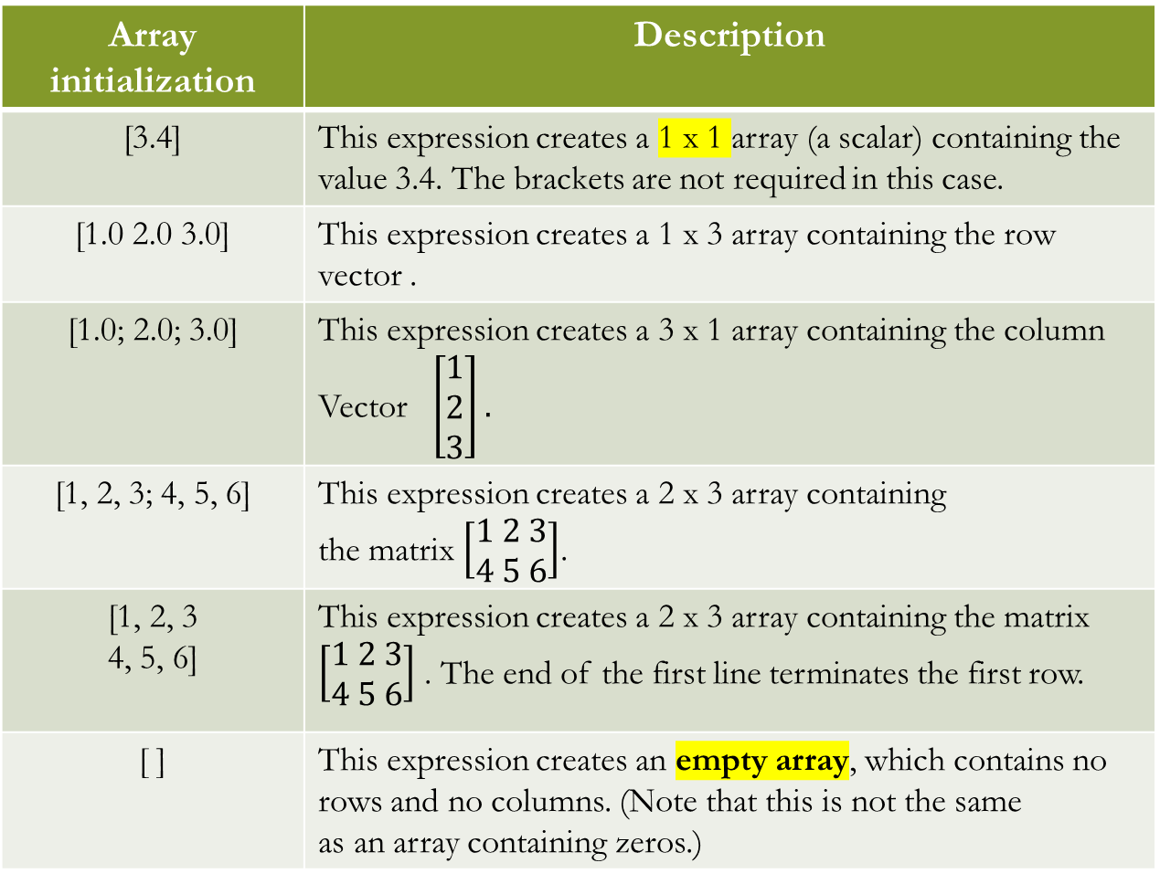
Array initialization | Description
[3.4] | This expression creates a 1 x 1 array (a scalar) containing the value 3.4. The brackets are not required in this case.
[1.0 2.0 3.0] | This expression creates a 1 x 3 array containing the row vector .
[1.0; 2.0; 3.0] | This expression creates a 3 x 1 array containing the column Vector $\left[\begin{aligned}1 \\ 2 \\ 3\end{aligned}\right].$
[1, 2, 3; 4, 5, 6] | This expression creates a 2 x 3 array containing the matrix $\left[\begin{aligned}1 2 3 \\ 4 5 6\end{aligned}\right]$.
[1, 2, 3 4, 5, 6] | This expression creates a 2 x 3 array containing the matrix $\left[\begin{aligned}1 2 3 \\ 4 5 6\end{aligned}\right]$ . The end of the first line terminates the first row.
[ ] | This expression creates an empty array, which contains no rows and no columns. (Note that this is not the same as an array containing zeros.)

Slide 17
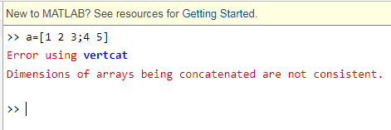
The number of elements in every row of an array must be the same, and the number of elements in every column must be the same.
An expression such as [1 2 3; 4 5]; is illegal because row 1 has three elements while row 2 has only two elements.

Slide 18
Hands-on Practice
1. a = [0 1+7];
b = [a(2) 7 a]; Observe b.
2. c(2,3) = 5; Observe c.
3. D= [1 2] and d(4) = 4; Observe d.

Slide 19
2. Initializing with Shortcut Expressions
first:incr:last
First-the first value in the series
Incr-the stepping increment
Last-the last value in the series
Notes:
The first example creates a scalar variable of type double and stores the imaginary number 40i in it.
The second example creates a scalar variable and stores the result of the expression var/5 in it.
The third example shows that multiple assignment statements can be placed on a single line, provided that they are separated by semicolons or commas.
The last example shows that variables can also be initialized with arrays of data. Such arrays are constructed using brackets ([]) and semicolons. All of the elements
of an array are listed in row order. In other words, the values in each row are listed from left to right, with the topmost row first and the bottommost row last. Individual
values within a row are separated by blank spaces or commas, and the rows themselves are separated by semicolons or new lines.
Note that if any of the variables had already existed when the statements were executed, then their old contents would have been lost.

Slide 20
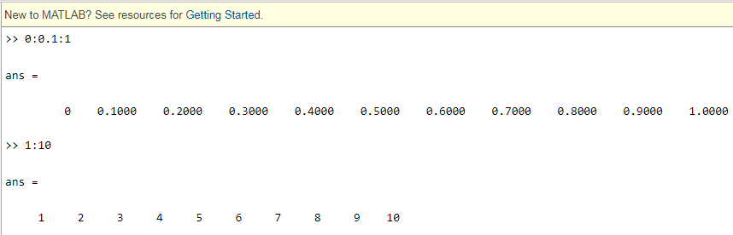


This operator will generate an array containing the values first, first+incr, first+2*incr, first+3*incr, and so forth as long as the values are less than or equal to last. The list stops when the next value in the series is greater than the value of last.

Slide 21
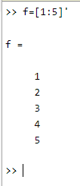
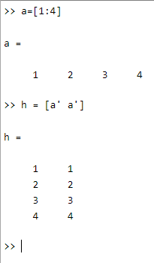

Shortcut expressions can be combined with the transpose operator (') to initialize column vectors and more complex matrices.

Slide 22
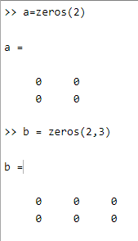
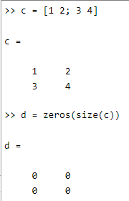
3. Initializing with Built-In Functions
a = zeros(2);
b = zeros(2,3);
c = [1 2; 3 4];
d=zeros(size(c));

Slide 23
Hands-on Practice
1. ones(n)
2. ones(m,n)
3. ones(size(arr))
4. eye(n)
5. eye(m,n)
6. length(arr)
7. size(arr)

Slide 24
Functions | Description
zeros(n) | Generates an nxn matrix of zeros.
zeros(m,n). | Generates an mxn matrix of zeros.
zeros(size(arr)) | Generates a matrix of zeros of the same size as arr
ones(n) | Generates an nxn matrix of ones.
ones(m,n) | Generates an mxn matrix of ones.
ones(size(arr)) | Generates a matrix of ones of the same size as arr.
eye(n) | Generates an nxn identity matrix.
eye(m,n) | Generates an mxn identity matrix.
length(arr) | Returns the length of a vector, or the longest dimension of a 2-D array.
size(arr) | Returns two values specifying the number of rows and columns in arr.

Slide 25
4. Initializing Variables with Keyboard Input
It is also possible to prompt a user and initialize a variable with data that he or she types directly at the keyboard. This option allows a script file to prompt a user for input data values while it is executing. The input function displays a prompt string in the Command Window and then waits for the user to type in a response.
Notes:
The first example creates a scalar variable of type double and stores the imaginary number 40i in it.
The second example creates a scalar variable and stores the result of the expression var/5 in it.
The third example shows that multiple assignment statements can be placed on a single line, provided that they are separated by semicolons or commas.
The last example shows that variables can also be initialized with arrays of data. Such arrays are constructed using brackets ([]) and semicolons. All of the elements
of an array are listed in row order. In other words, the values in each row are listed from left to right, with the topmost row first and the bottommost row last. Individual
values within a row are separated by blank spaces or commas, and the rows themselves are separated by semicolons or new lines.
Note that if any of the variables had already existed when the statements were executed, then their old contents would have been lost.

Slide 26
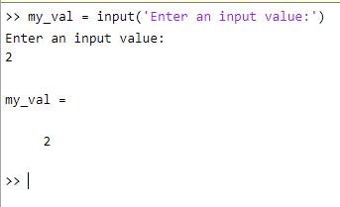

Slide 27
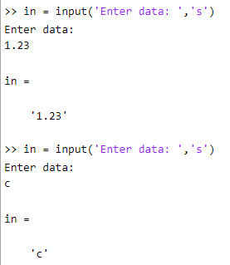
If the input function includes the character 's' as a second argument, then the input data is returned to the user as a character string.

Slide 28
Outline
Variables and Arrays
Creating and Initializing Variables in MATLAB
Multidimensional Arrays
Subarrays

Slide 30
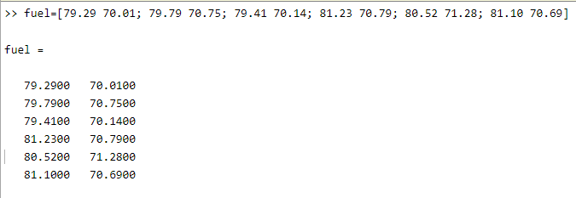
Some types of data are functions of more than one independent variable.

Slide 31
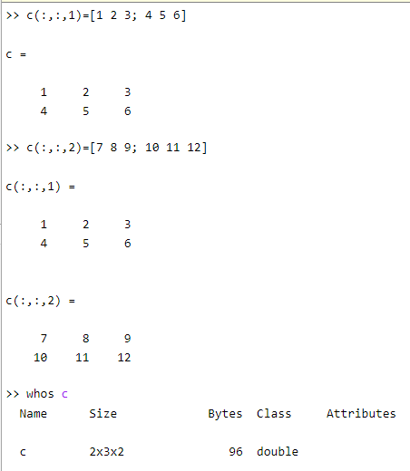



Slide 32
Storing Multidimensional Arrays in Memory

Slide 33
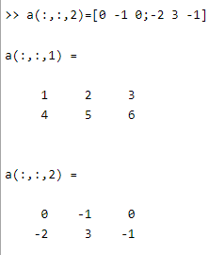
The allocation scheme applies to arrays with more than two dimensions in the following order: (1,1,1), (2,1,1), (1,2,1), (2,2,1), (1,1,2), (2,1,2), (1,2,2), (2,2,2).

Slide 34
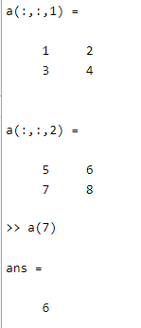
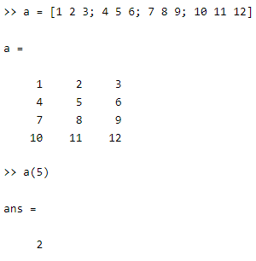

Accessing Multidimensional Arrays with One Dimension
If a multidimensional array is addressed with a single dimension, then the elements will be accessed in the order in which they were allocated in memory.

